Slide 1
Command Line Security Tools

Slide 2
ipconfig and ifconfig
To determine the IP address or network connection status of a system, use one of the following tools
ipconfig – Windows TCP/IP configuration
ifconfig – Linux interface configuration
ip – Linux tool similar to ifconfig but more functionality
These tools can tell you if you have an IP address, allow you to reset a DHCP assignment, assign a static IP address, determine your interface’s MAC address and more
A fair amount of network troubleshooting involves use of these tools

Slide 3

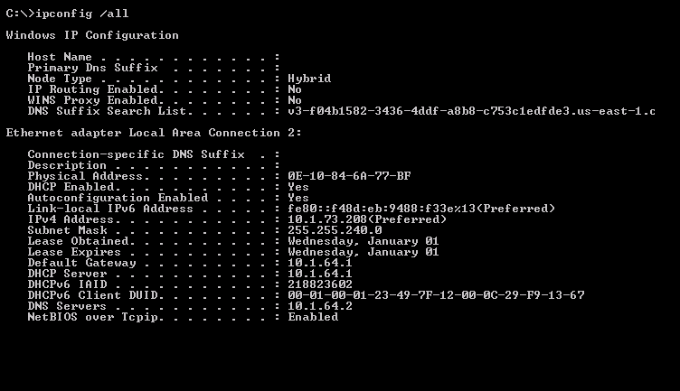
ipconfig : provides network networking configuration information

Slide 4

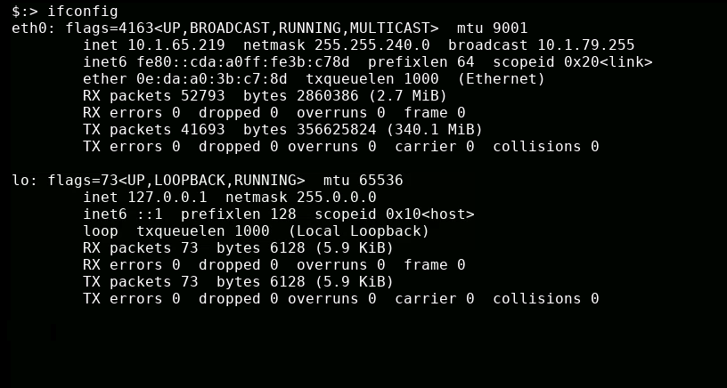
ifconfig : provides network interface configuration information

Slide 5
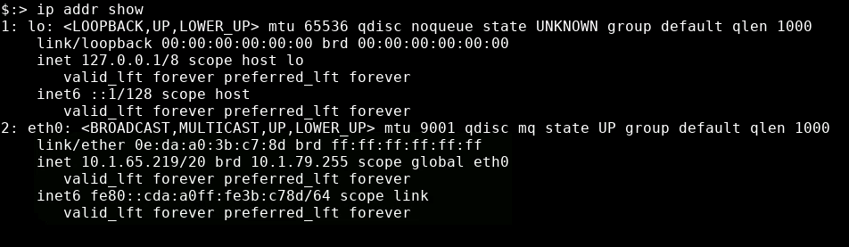
ip link show : displays status of network link layer devices
ip addr show : displays addresses assigned to devices (MAC, IPv4, IPv6)

Slide 6
ping
Tests network connectivity by sending an echo request via Internet Control Message Protocol (ICMP) to the specified host
Tool responds with round-trip time (in milliseconds)
1ms = 1/1000 second
Also provides Time To Live (TTL) of the ICMP request
TTL varies by operating system:
Windows = 128
Linux = 255
Mac = 64

Slide 7
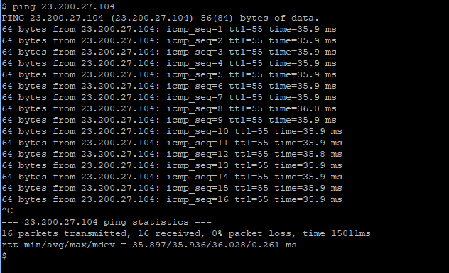
ping – timing of ICMP request to/from host
In Linux: sends requests until stopped by CTRL+C

Slide 8
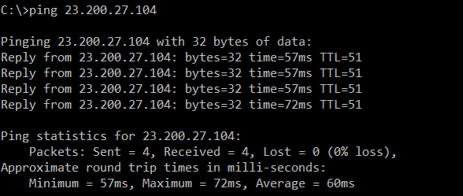
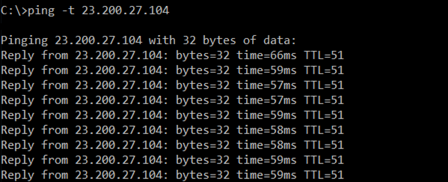
ping : ping from Windows will only send 4 requests by default
ping -t : sends requests until stopped by CTRL+C

Slide 9
traceroute
Determines path a packet takes to a destination
traceroute on Linux
tracert on Windows
tracepath on Chromebook
Uses ICMP Time to Live Exceeded error message
TTL refers to number of hops, not actual time
Not always accurate
Some networks block ICMP requests
Some networks deprioritize ICMP requests
Hops not responding shown with asterisk ( * )

Slide 10
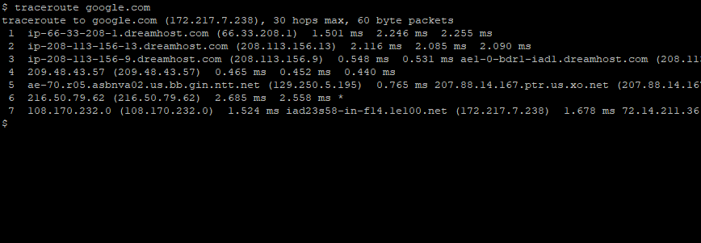
traceroute : provides list of “hops” between source and destination host

Slide 11
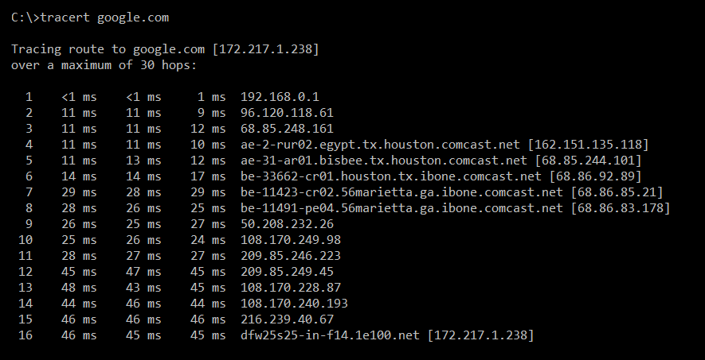
tracert : provides list of “hops” between source and destination host

Slide 12
nslookup and dig
Query DNS servers
“What is the IP address for <hostname> ?”
nslookup
Simple lookup of domain names and matching IP addresses
dig
Domain Information Groper
More detailed domain information
A record : Address of network
MX record : “mail exchange” (server than handles inbound email)
NS record : name servers (DNS) responsible for this domain
TXT record : notes for other networks to reference (serves many purposes)
SOA record : Start of Authority, the primary authoritative DNS server

Slide 13
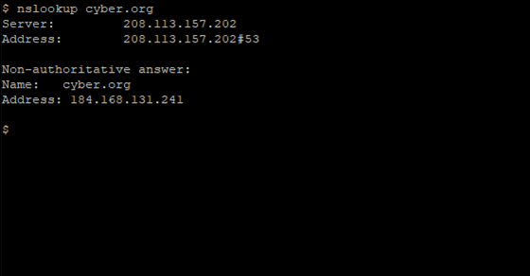
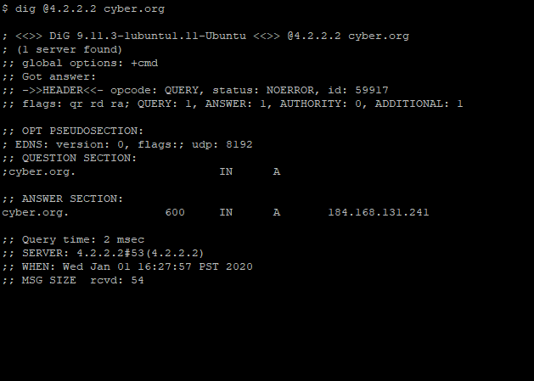
nslookup : simple IP resolver
dig : more DNS info

Slide 14
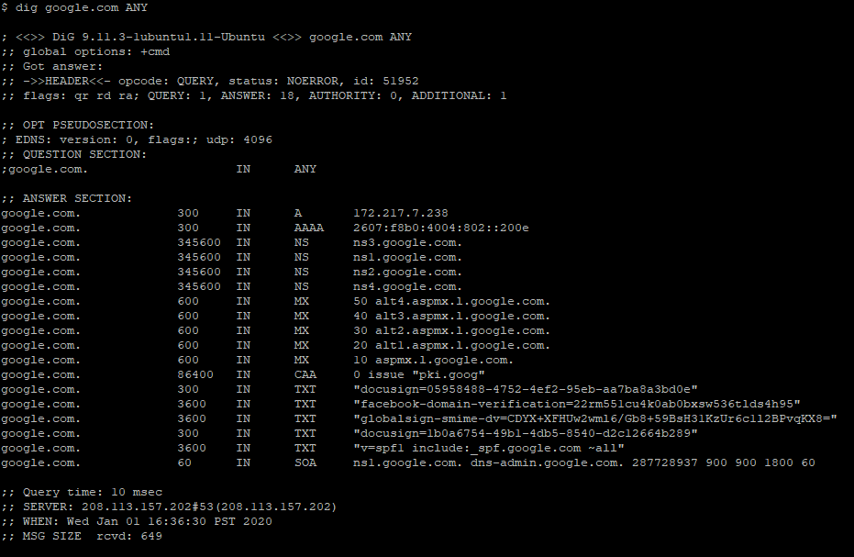
dig ANY : provides all DNS information (nameservers, mail exchanges, certificate auth, IPs)

Slide 15
arp
Address Resolution Protocol (ARP)
arp command allows you to view/modify the arp table on the host
arp
View host’s ARP table, formatted into columns
arp -a
View host’s ARP table, no columns
arp -n
Show numeric address, do not resolve hostnames
arp -d <ip_addr>
Remove ip_addr from ARP table

Slide 16
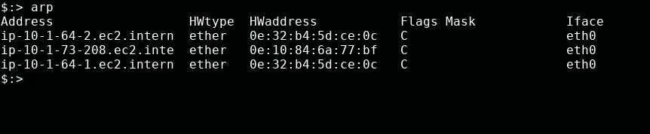
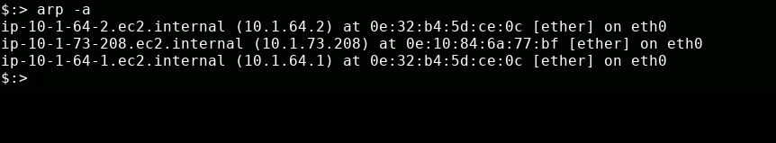
arp – formatted output of ARP cache showing hostname (address) and associated MAC
arp -a – output of ARP cache showing hostname (address) and associated MAC

Slide 17
netstat
Monitors network connections to and from host
Network statistics
Displays all ports host is listening on
Many options
netstat -a
Show all active connections
netstat -at
Show all active TCP connections
netstat -n
Do not resolve names

Slide 18
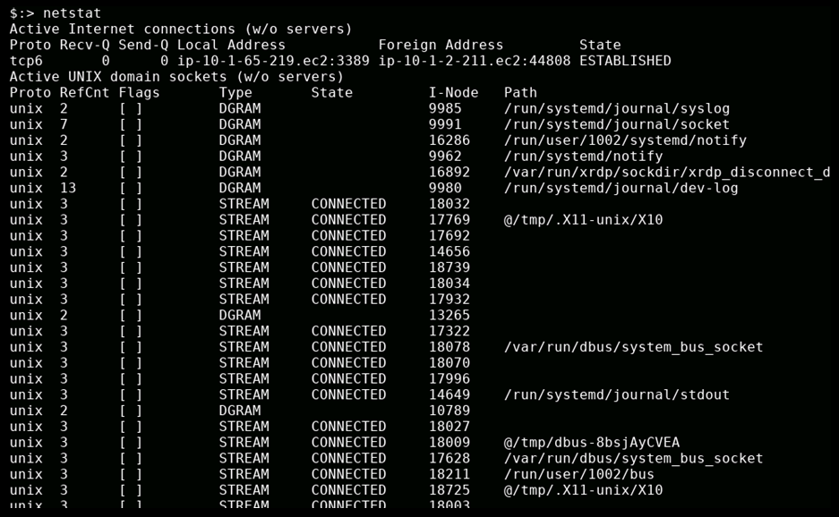
netstat : status/statistics for network connections on host

Slide 19
tcpdump
Packet analyzer (Wireshark of command line)
Filters give ability to only view certain packet types
Record network traffic and write to pcap file
Very useful, usually for feeding into another tool

Slide 20
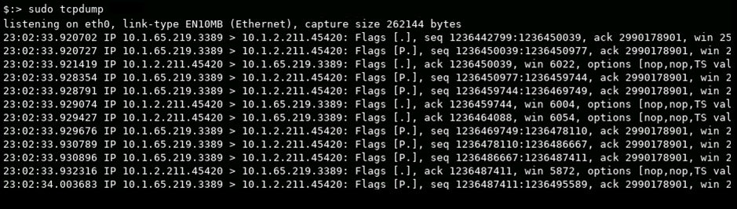
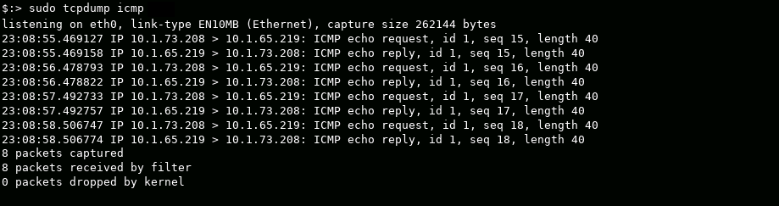
tcpdump –nn : show all packets
tcpdump icmp : watch for only ICMP packets [Four ping requests from a windows host]
Notes:
tcpdump –nn will not resolve hostnames or port names, just show where the activity is
tcpdump icmp shows only icmp traffic (or, tcp, udp…) tcp port 53 to capture DNS traffic (can also see what domains the host is trying to find IP address for)

Slide 21
nmap
Network Mapper
Search for hosts on a network
Scan range of IP addresses
Rogue system detection (“Wait, who is that IP address?”)
Scan for open ports on host
Identify services available on a host
Fingerprint operating systems
“What’s OS is behind that IP?”
NSE files (nmap scripting engine) allows for more specialized scans, helps filter complex queries

Slide 22
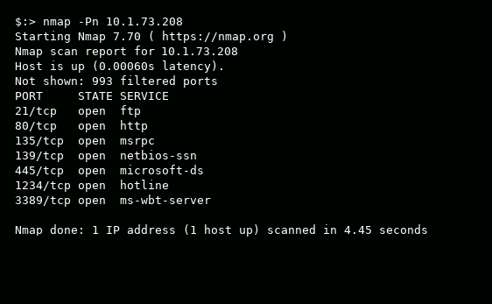
nmap : scanning all ports on local IP address
What OS is the target system running?
What kind of servers is running on it?

Slide 23

netcat
Read and Write directly to network interface
Open port and communicate directly via TCP or UDP packets
Versatile tool – command is actually nc
Monitor a port
Transfer data via a port
Simple port scan
Basic telnet client
Quick, easy backdoor
Select port to operate on
Open a “hotline” service for remote connection
Transfer plain text through netcat backdoor

Slide 24
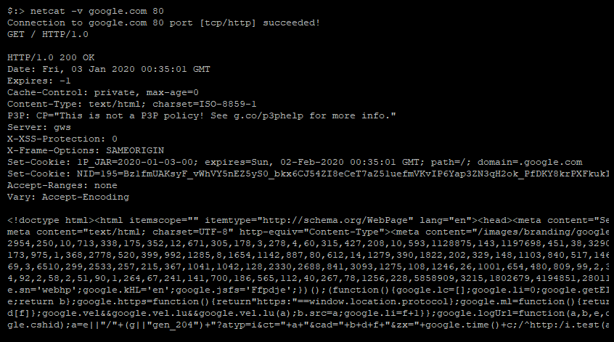
netcat : connecting to public web server and requesting HTML document [ / ]
HTML header information
HTML contents

Slide 25
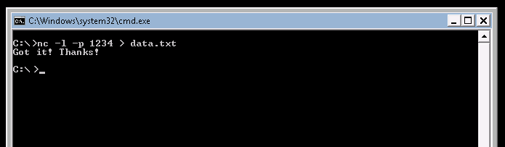

nc – Windows host creates “listen” server on port 1234 Stores incoming data in data.txt file When data arrives, user sends message saying file received
nc – Linux host connects to server over port 1234 Sends contents of data.txt file Sees message from recipient saying file received CTRL+C closes connection

